Slide 1
A
Presentation on
IML
Assignment
BY:
Rounak Kumar

Slide 2
The House Price Prediction Problem
In this problem, we have been given a dataset that records the house prices of 9,761 houses in King County, Washington, US. The house prices are recorded along with some other attributes like - area of the house, number of bedrooms, number of bathrooms, etc.
The relationship between house prices and the economy is an important motivating factor for predicting house prices. Housing price trends are not only the concern of buyers and sellers, but it also indicates the current economic situation. Therefore, it is important to predict housing prices without bias to help both the buyers and sellers make their decisions.

Slide 3
Data Description
date: Categorical variable showing date of sell
bedrooms: Continuous Variable showing number of bedrooms in house
bathrooms: Continuous Variable showing number of bathrooms in a house
sqft_living: Continuous Variable showing living area in sq.ft.
sqft_lot: Continuous Variable showing lot area in sq.ft.
floors: Continuous variable showing number of floors
waterfront: Categorical variable 0 indicating No waterfront and 1 indicating waterfront near house
condition: Categorical variable showing condition of house on scale of 5
grade: Categorical variable showing grade(Quality of the construction) on scale of 13
sqft_above: Continuous variable showing Sqft_above for house
sqft_basement: Continuous variable showing basement area in sq.ft for house
yr_built: Categorical variable Build year of house
yr_renovated: Categorical variable showing house renovated year
zip code: * zip code of location of house
lat / long: Latitude and longitude of the House
sqft_living15: Continuous Variable showing living area in sq.ft as on 2015.
sqft_lot15: Continuous Variable showing lot area in sq.ft as on 2015.
Target Variable Y: Price

Slide 4
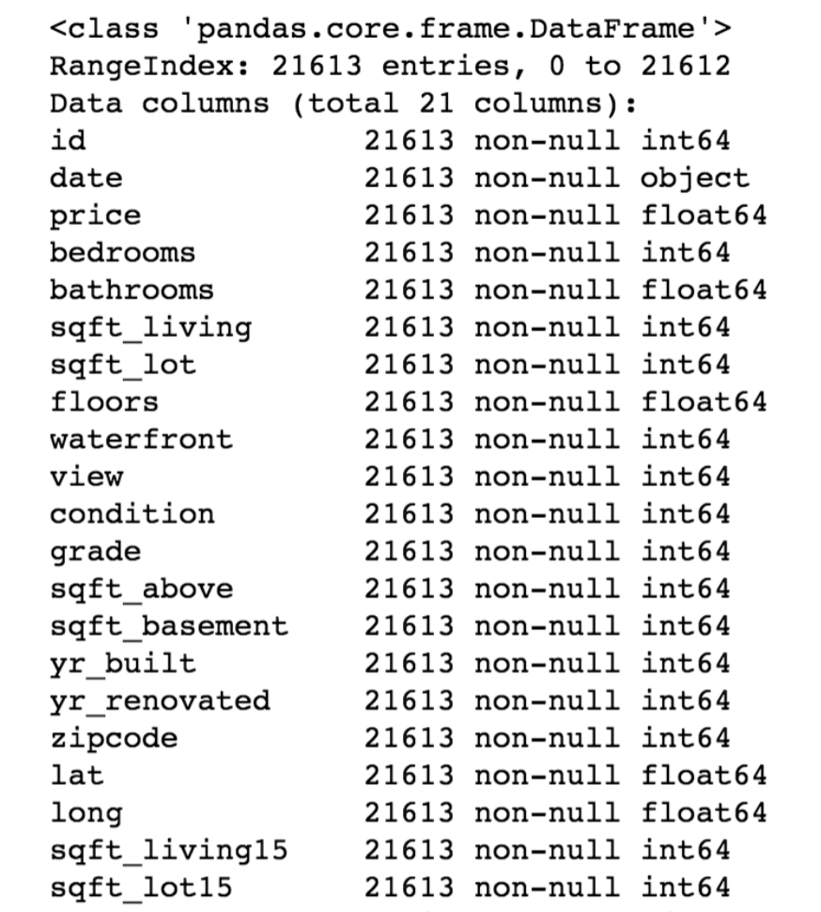
Data Types

Slide 5
Conclusion on the Data
From the table shown above, we can see the independent variables from the housing dataset are the explanatory variables.
The independent variables are date, price, bedrooms, bathrooms, sqft_living, sqft_lot, floors, waterfront, view, condition, grade, sqft_above,sqft_basement, yr_built, yr_renovated, zip code, latitude, longitude, sqft_living15, and sqft_lot15.
We can see that these variables include categorical variables, numerical variables, and time series variables.
The dependent variable is the sale price of houses

Slide 6
Creating Hypothesis and asking Questions
After first glance over data and understanding variables we can formulate below Questions/hypothesis about data:
Usually House prices increase with the increase in size of the house. So, does increase in sqft_living area, sqft_lot area shows increase in price?
Bigger the house more is the price. Number of floors, number of bedrooms, bathroom has any effect on price?
The Housing prices are seen to be dependent on the age of the house. Older Houses gets lower prices. Is our data supporting this?
Is condition of the house has any effect on the price? Are houses with high condition rating (good conditioned) are priced more compared to low condition rating (Bad conditioned) houses?
Do people prefer to live near waterfront paying higher prices? People usually like to live near to the nature.
Better constructed houses last for many years. Does grade (construction Quality of House) has any effect on prices? Is House with Lower grade getting lower price?
Houses which has undergone renovation gets more prices?

Slide 7
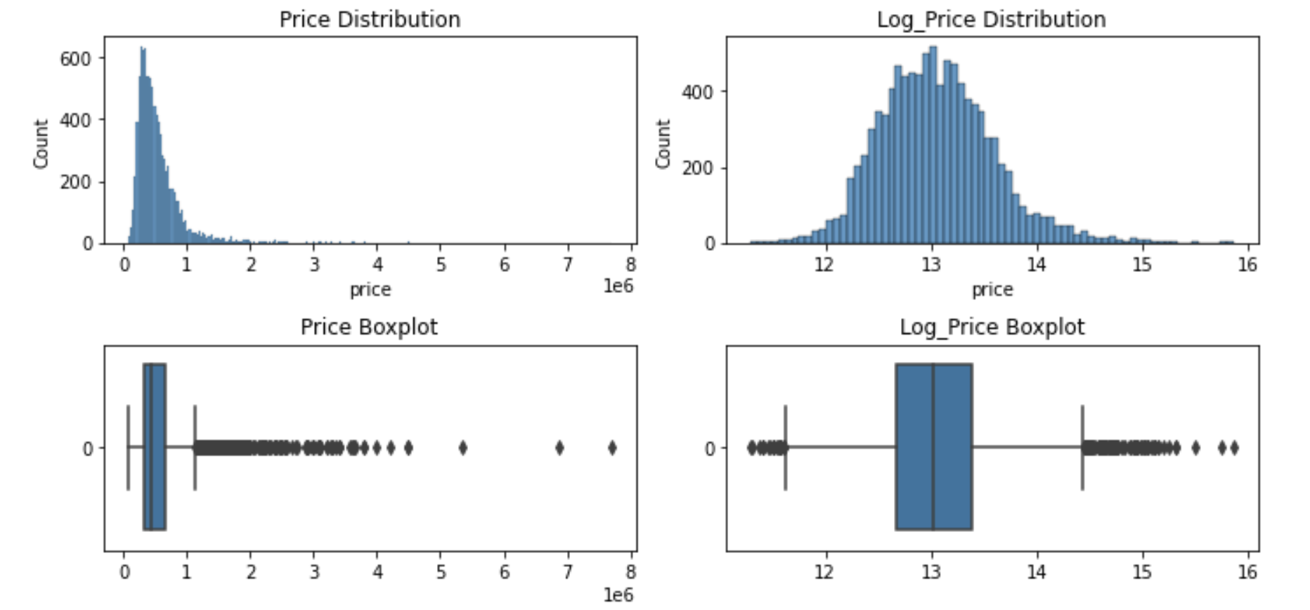
Target Variable Y
Price
When plotting the graph for the Target Variable Y, we see that the curve is right or positive skewed. So, we use log to convert it into a Normal distribution. And we also check for the outliers with the help of a boxplot for the same.
interquartile range, upper boundary, lower boundary: (329000.0, 1142500.0, -173500.0) mean=5,42,734 dollors

Slide 8
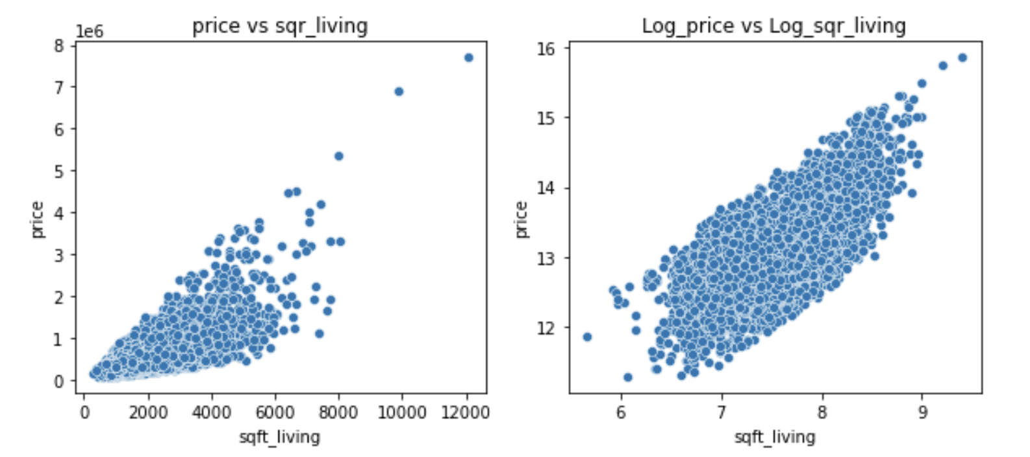
EDA
We not do the analysis of different variable with respect to Price and see the relation between them. This will give us an idea of the fluctuations in price with respect to different variables. Also, in some cases, we use a log to get a more linear relationship between variable and prices. The relationships are as follows:
Square feet living area

Slide 9
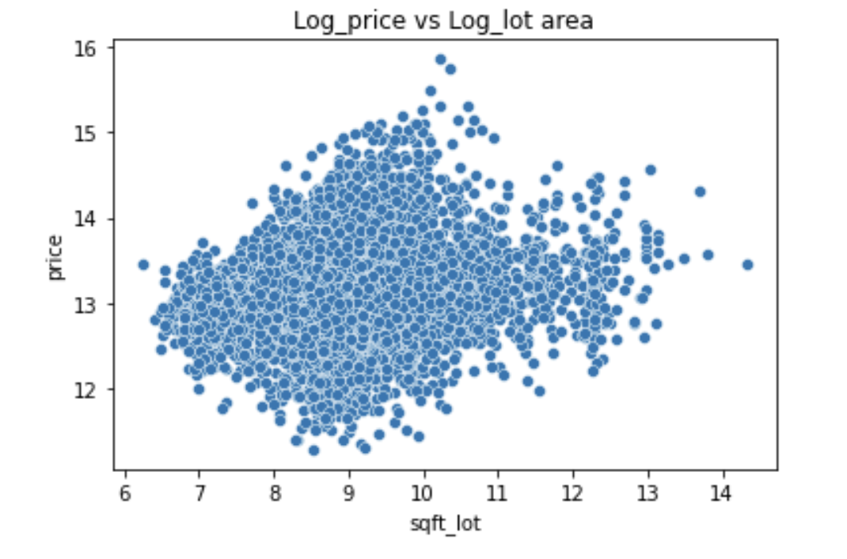
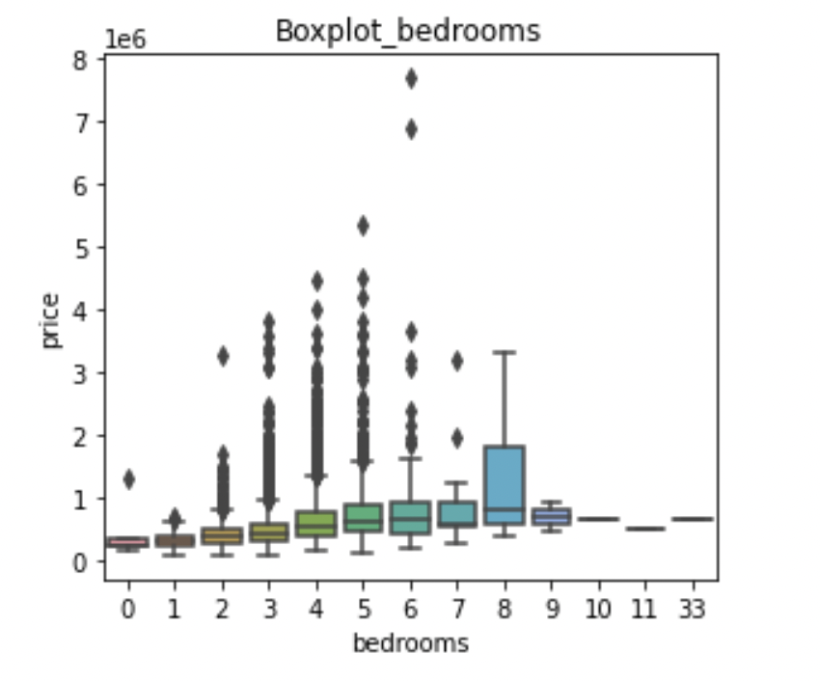
Square feet lot Vs Price
Bedrooms Vs Price

Slide 10
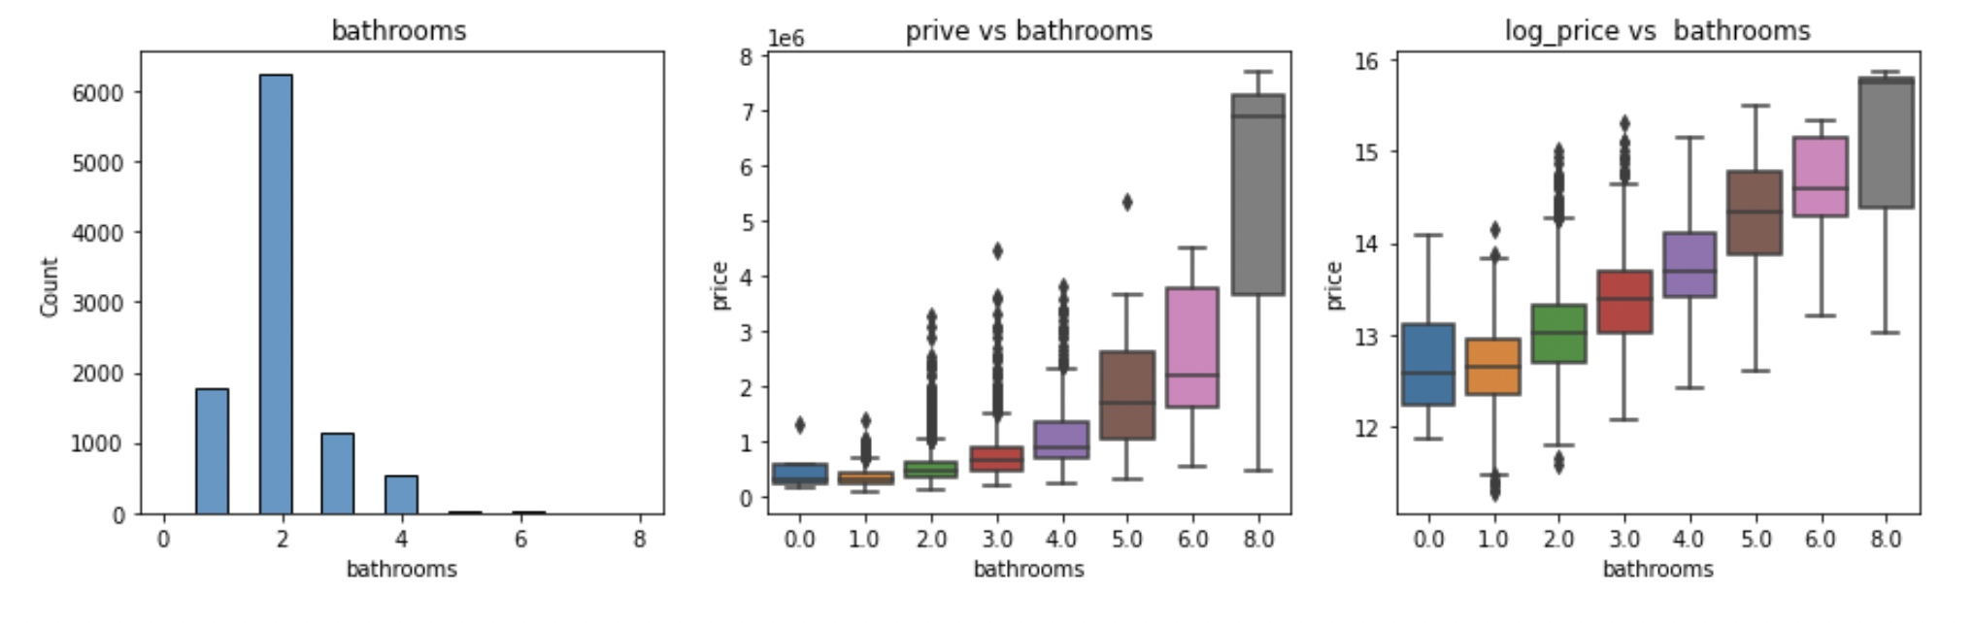
Count of Bathrooms
Bathrooms Vs Price

Slide 11
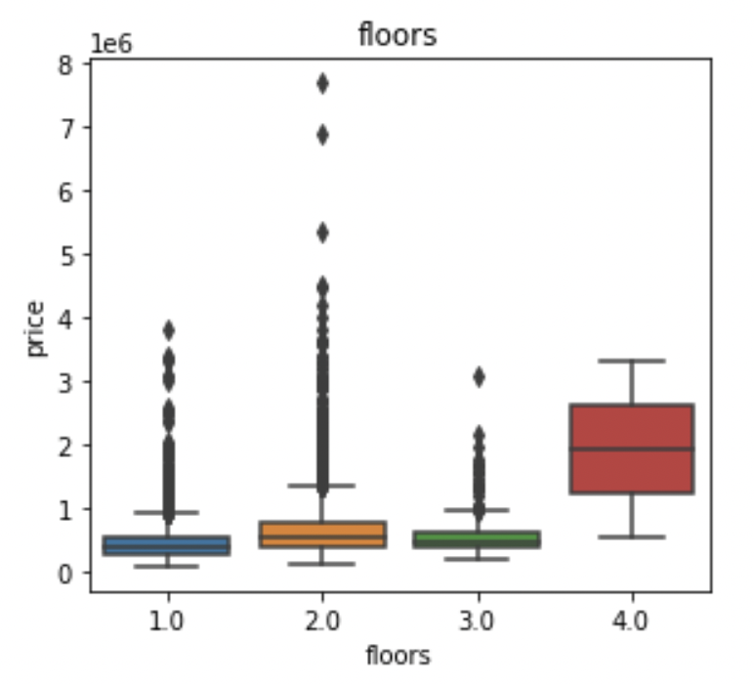
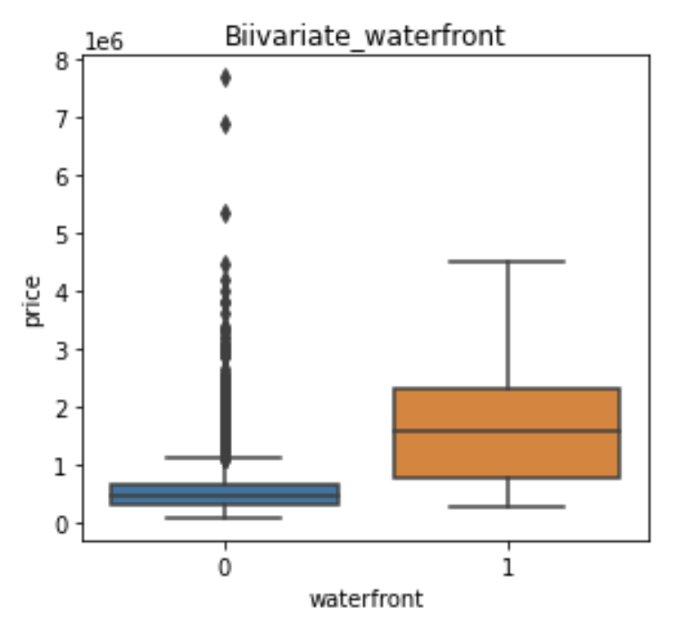
Floors Vs Price
Waterfront Vs Price

Slide 12
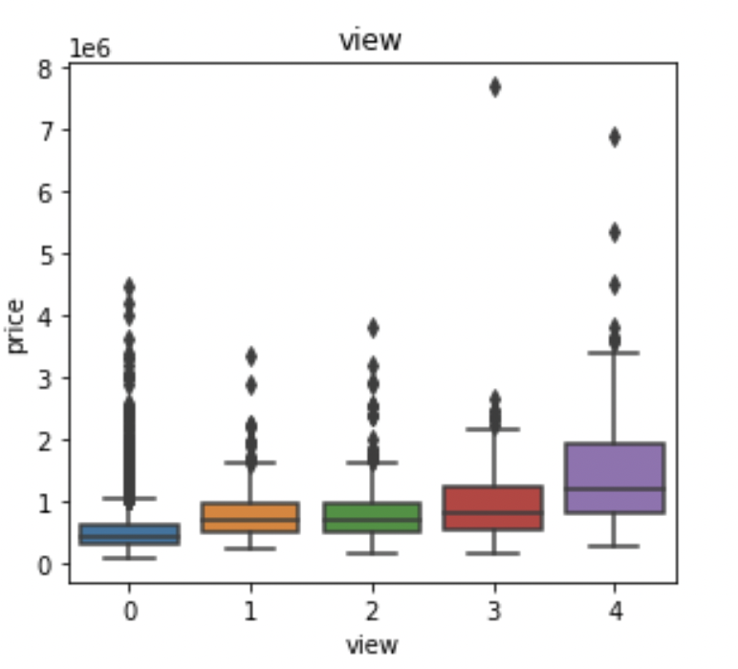
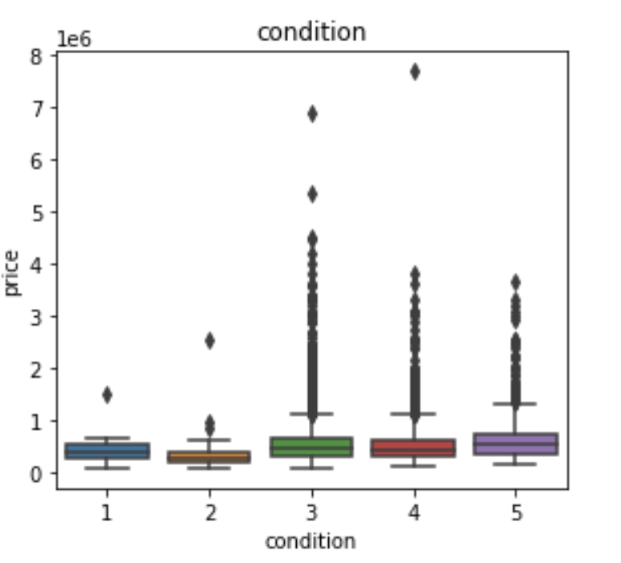
View Vs Price
Condition Vs Price

Slide 13
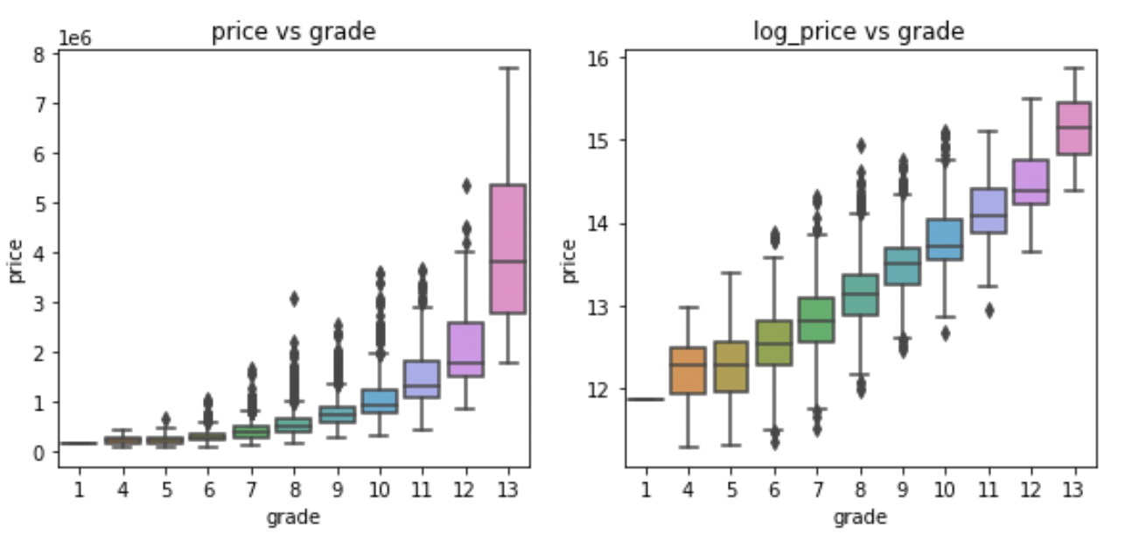
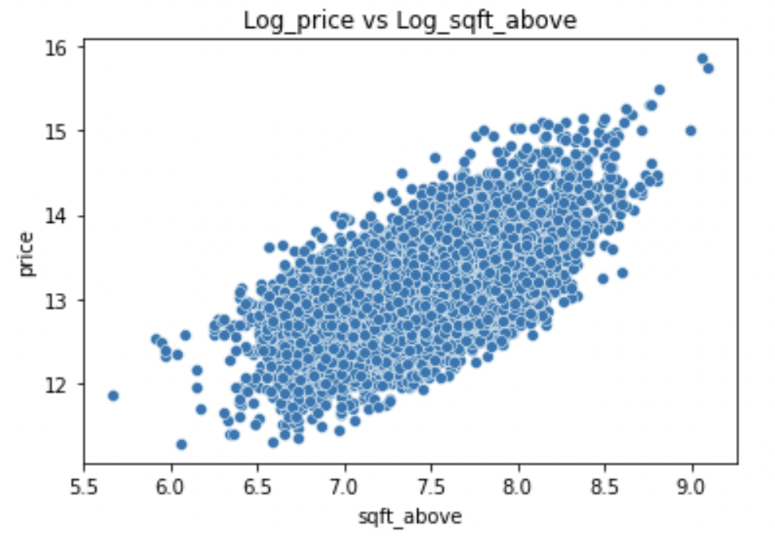
Grade Vs Price
Sqft_above Vs Price

Slide 14
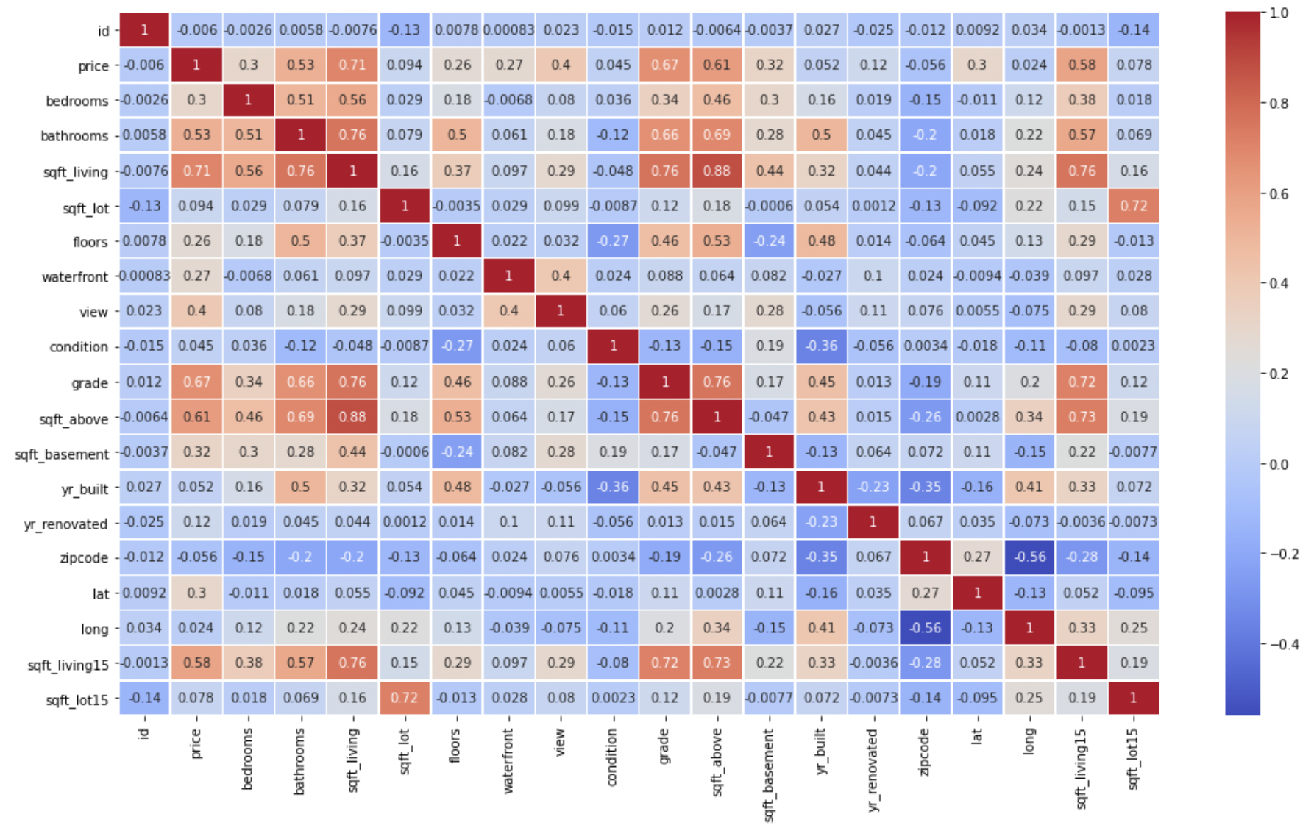
Comparing the different variables with the help of Heat

Slide 15
Summary of EDA
Predictors that may affect the Target
sqft_living
grade
bathrooms
sqft_abve (highly correlated with sqft_living and can be dropped)
sqft_living15 (highly correlated with sqft_living, can be dropped )
view (less significant)
bedroom (less significant)
waterfront (less significant)
lat (less significant)
Predictors that may NOT affect the Target
id
date
sqft_lot
floor
condition
yr_built
yr_renovated
Zip code
long

Slide 16
Results
Results that supports our Hypothesis
The house price increases with size of house i.e. living area of the house.
House with more number of bathrooms and bedrooms see higher prices.
People pay higher prices for better built houses i.e house with higher grade.
House with views gets slightly more price.
Most of the people do not live near waterfront, but prices of houses are higher for such houses.
Results that do not support our hypothesis
Lot area of the house do not affect the prices of house. People prefer bigger living area over bigger lot area.
Increased number of floors do not show increased in prices.
Condition of house do not affect the house prices.
Houses price are not very dependent on year of renovation.

Slide 17
Fitting Linear Regression Model
We then check the RMSE value for different variables when compared with Price. This is followed by comparing the RMSE value for each variable or variables. Which tells us which which model is most accurate, i.e., with the least error.
Results
After fitting couple of initial models, we see that sqft_living being highly correlated feature contribute more to the performance of the model. Keeping sqft_living as baseline and adding few combination of features we tried to evaluate the features that could improve the performance of the model.
The Quality of constructions helps the model to improve the performance.
The number of bathrooms when used along with sqft_living seems to be not contributing enough to improve the r square.
View and waterfront with sqft_living improve the r square from 0.49 to 0.55.
The location of the house('lat','long') contribute to the model performance.

Slide 18
Feature Engineering
A) Log Transformation:
The dataset has lot of outliers which cases data to be right skewed for few parameters. The outliers effect can be reduced using log transformation. log transformation reduces or removes the skewness of our original data. Log Transformation cannot be used on data with 0 and -ve value observations.
The distribution of target price is right skewed. we can use log transformation. but the predicted values will be log of price which need to back transformed by exp(price)
The sqft_living feature is right skewed due to outliers trying log transformation to check if it helps.
B) New feature generation:
Generated new feature house_age using year build. This new feature helps increasing r_square of the model.

Slide 19
Model fitting step 2 (Linear Regression)
Using Forward Selection Method
Forward Selection Method:
Feature variables examined one at a time.
Use stopping rule (such as r square, adj r square, p value) that acts as a hurdle the variable must overcome to be allowed in a model.
Added feature must reduce error significantly.
once variable added to model it stays and never removed
Then the process repeats until all variables are in model or no variable passes the stopping rule.
The ability of variables to reduce error can change as other variable enters the model
Competing models:
Model_9 : Target = [ Price ] , Predictors ['sqft_living','lat','grade','house_age','view','waterfront','bathrooms'] r²=0.76
Model_5 : Target = [ Price ] , Predictors = ['sqft_living','lat','grade','house_age','waterfront' ] r²=0.75
Model fitting step 3 (Decision Tree)
The decision tree gives better results when we transformed target variable log_price compare to the original variable price.
The r_square for the Decision tree is 0.70 which is little less for the models we have selected for Multiple linear regression.

Slide 20
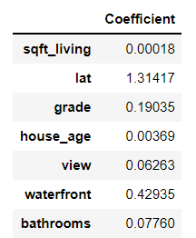
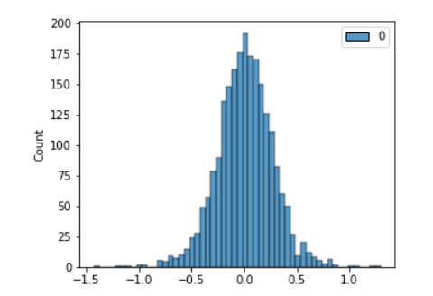
Model Testing and Results
Coefficients model 9
RESULTS:
The model 9 has less r² and RMSE compare to Model 5.The Model 9 is best performing model.
In model 9 features ['sqft_living','lat','grade','house_age','view','waterfront','bathrooms'] are able to explain 71% of the variation in house prices
 | Model 9 | Model 5
r² | 0.71 | 0.69
RMSE | 193872 | 197251
Residual Distribution model 9

Slide 21
Thank You

